Slide 1
HOMY SHOPPING
SHOPPING WITH EASE !!!
Case Study done for PLANdemic !

Slide 2
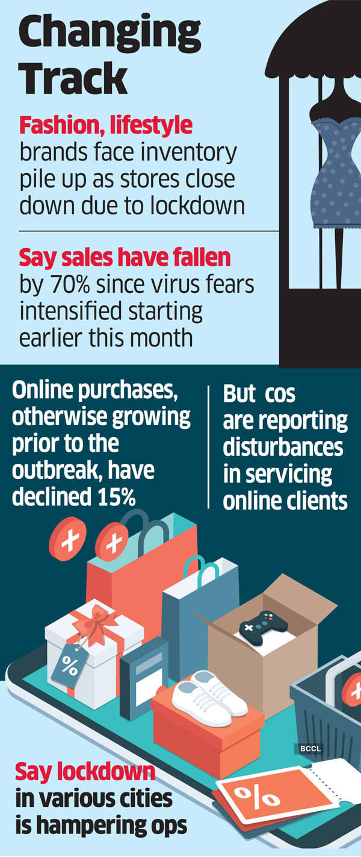
PROBLEM and RESEARCH
During this corona pandemic situation its not viable to go outside and shop clothes as there is a high risk of getting infected.
As a result the textile sector of our country was heavily affected by this pandemic and the stock prices of this sector drastically fell.
So our Team NAV are trying to bring the whole shopping experience to online where one can get the same traditional shopping experience (i.e. Going to shop and trying the clothes to check whether that shirt or jeans is of proper fit for them or not) to online using 3d body scanners and Augmented Reality.

Slide 3

IDEA
The idea is that, using Augmented Reality we give our customers a virtual environment of the shop where they can roam around and select the clothes they like. Then with help of a 3d body scanner, we will get there body measurement.
Then using a 3d rendering, we will be able to render a 3d image of the customer in the clothing they chose, as a result they would be able to see how they look in that particular clothing.
If they like the clothes they are wearing, then the app will take them back to the billing section or else if they want to shop more then they will be taken back to the virtual shop.
Our advertisement will explain you the idea clearly
https://youtu.be/ZfD8rP77d2Q

Slide 4
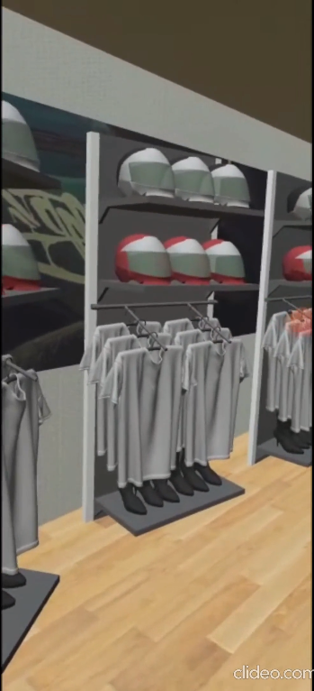
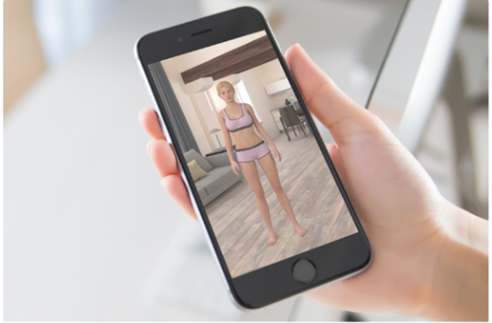
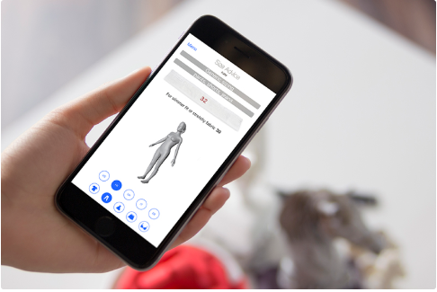
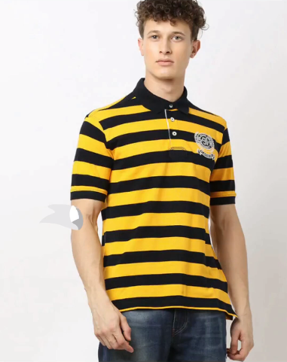
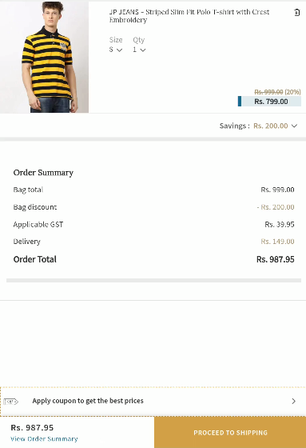
SCAN YOUR BODY
YOUR SIZE WILL BE DISPLAYED ON THE SCREEN
By AR we are bringing our shop to your home !
Select the dress by clicking on it
AN AUGMENTED IMAGE OF YOU WILL BE CREATED WEARING THE CLOTHES YOU CHOOSE
BILLING SECTION

Slide 5

Target audience
Using this idea we are trying to cover a wide range of customers around the country. Mainly for those whose marriages and other functions which had been planned during this time. We are also trying to cover common people who want to do there weekend shopping's. And also for the users who don’t like to go out and shop.
Let us take an example of a marriage function, dress for the groom is yet to be designed, and most of the marriages nowadays are happening in a very small scale, so we suggest our app to take the perfect measurement of the groom and it matches the dresses correct to his size and will give the correct choice for him.

Slide 6
SETTING BUDGET
We did a prototype and demoed a video and published in social media.
For this, video making and video editing is done by ourselves.
We created in a way of easy understanding to the viewers.
For this project to be completed we have a budget and permission from each shop.
Store those data in Mapbox – Used in unity.
If montly active users is below 25000 it’s free .
If 100000 users $ 4.00 (for 1000)
If 125000 users $ 3.20 (for 1000)
If 410000 users $ 2.40 (for 1000)
Cost per 1000 decreases with increase in users.

Slide 7

Deciding a proper theme
So for a perfect company, needs a perfect logo.
We have developed our own logo that represent us and our work among the people. So when ever they see our logo, they will remember our company.
We implemented our campaign with having reliance as an example.
We used AJIO app as an interface and developed our own AR portal and interfaced with it for making an demonstration video.
By bringing the shop to the home(AR), one can achieve the satisfaction of being purchased in the outdoor.
This is a major and upcoming big issue, but by this idea we can solve this.
For better understanding see the video https://youtu.be/ZfD8rP77d2Q
This is our logo NAV which represents our company

Slide 8

SELECTION OF MEDIA
We are mainly using the social media platforms like INSTAGRAM, FACEBOOK, LINKEDIN, TWITTER, SNAPCHAT, PINTREST etc.
The main reasons are -
Cost-Effective - Social media marketing is possibly the most cost-efficient part of an advertising strategy. Signing up and creating a profile is free for almost all social networking platforms, and any paid promotions you decide to invest in are a relatively low cost compared to other marketing tactics.
Gain Marketplace Insights - By monitoring the activity on your profiles,, you can see customer' interests and opinions that you might not otherwise be aware of if your business didn't have a social media presence.
Increased Brand Awareness- Social media is one of the most cost-efficient digital marketing methods used to syndicate content and increase your business' visibility. Implementing a social media strategy will greatly increase your brand recognition since you will be engaging with a broad audience of consumers
Better Customer Satisfaction - Creating a voice for your company through these platforms is important in humanizing your company. Customers appreciate knowing that when they post comments on your pages, they will receive a personalized response rather than an automated message. Being able to acknowledge each comment shows that you are attentive of your visitors' needs and aim to provide the best experience.
We mainly did a demoed video of our working prototype and posted in social media.
We posted in Instagram as an IGTV video, Instagram, Twitter,Whatsapp groups,etc.
We also trended it by #NAV in tweets.

Slide 9
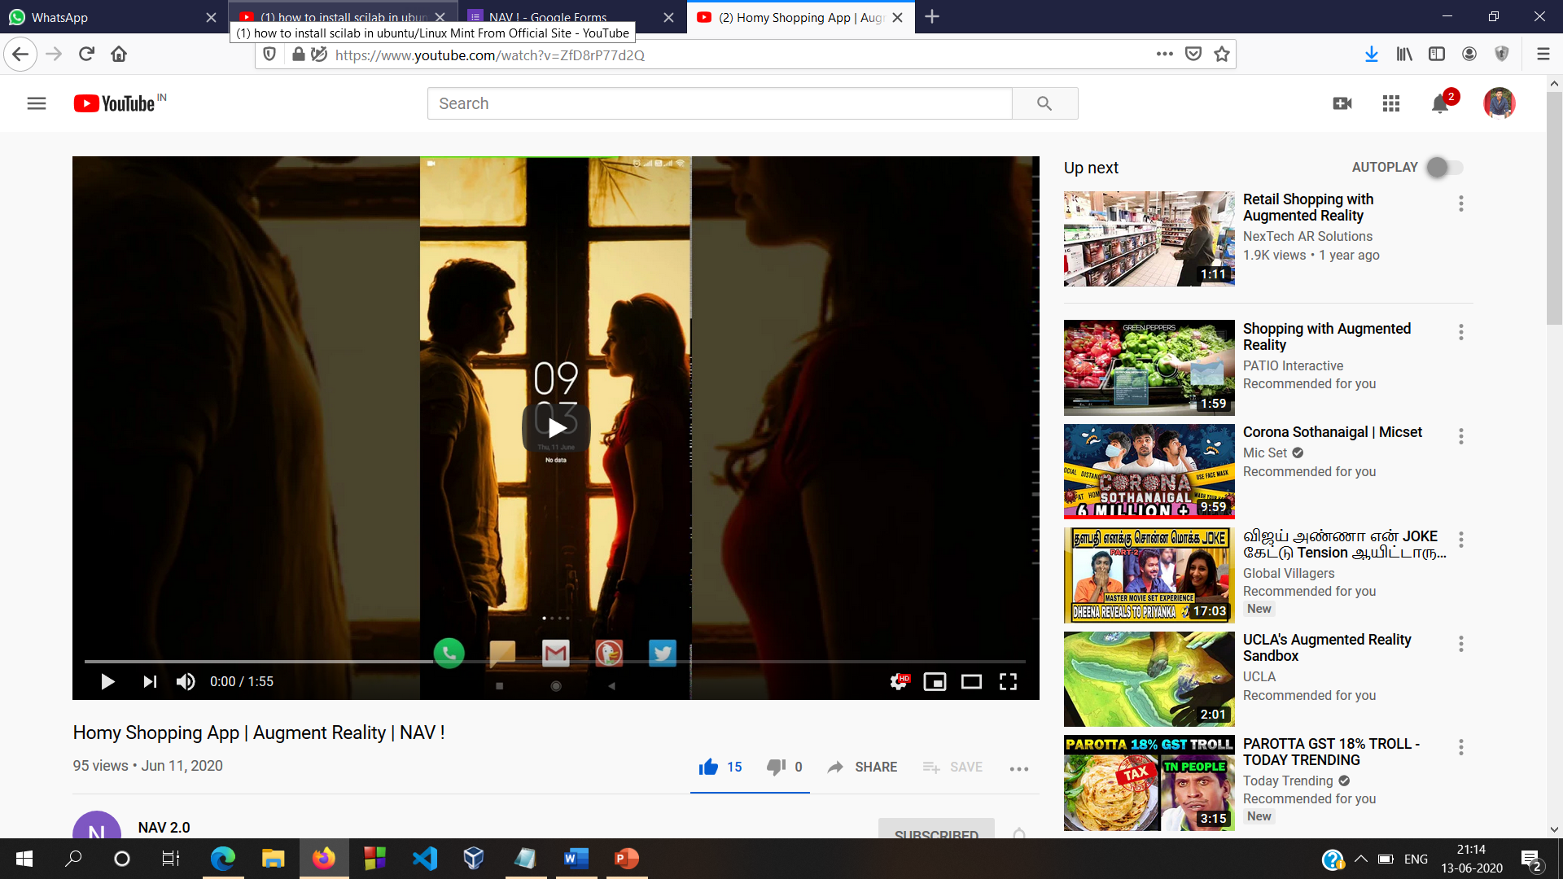
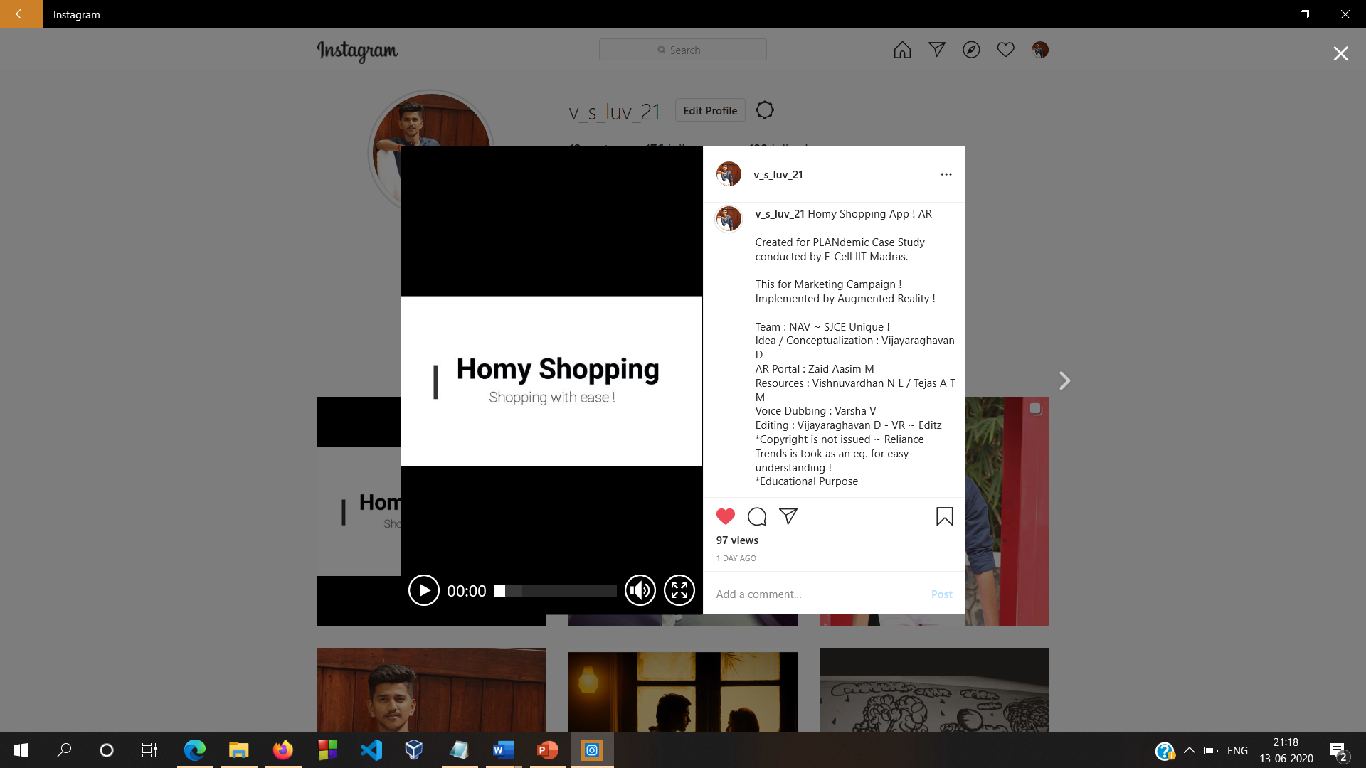
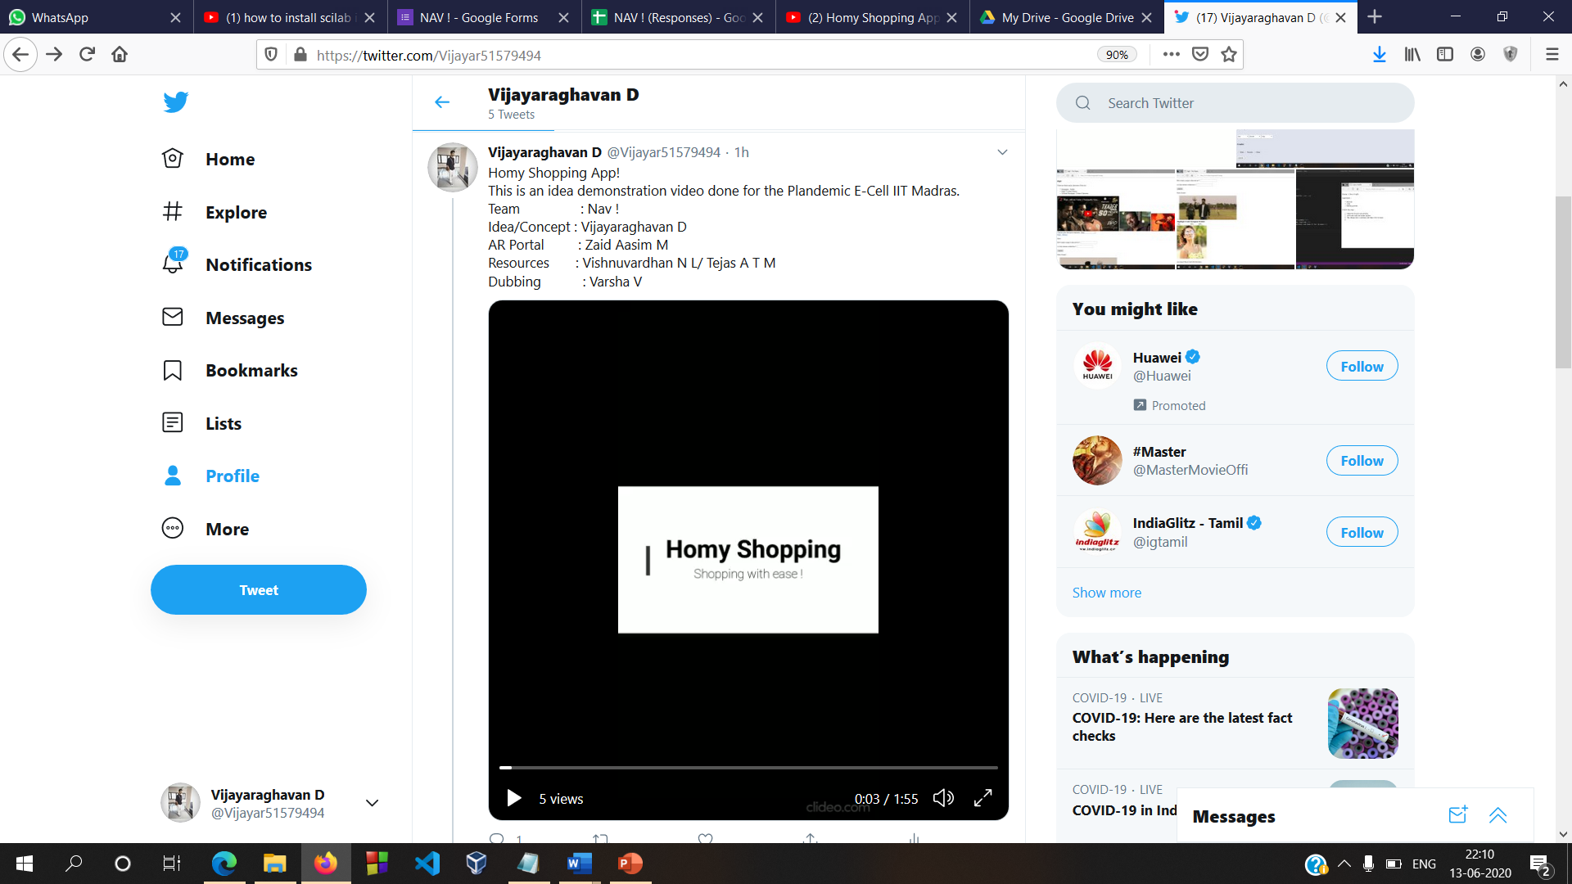
Executing the campaign
We executed our campaign in different platforms : Youtube, Instagram, Twitter, Whatsapp, etc.
Youtube : https://youtu.be/ZfD8rP77d2Q
Instagram : https://www.instagram.com/tv/CBT1Yw_lPjC/?utm_source=ig_web_copy_link
Twitter : https://twitter.com/Vijayar51579494/status/1271819069008703489?s=08
Collected feedback in google forms : https://docs.google.com/spreadsheets/d/114NvuZ9ODy2k5JVWHQ4pl_skd6hO8E4isDhMTIGifYs/edit?usp=sharing
A report of advertisement views :
https://drive.google.com/file/d/1Y0CqS0TQGeeJFMVuCqpYaY5-ApKnrbJY/view

Slide 10

College Name : St.Joseph’s College Of Engineering, OMR, Chennai.
Team Name : NAV
Team Members : Vijayaraghavan D
Zaid Aasim M
Tejas A T M
Vishnuvardhan N L
Advertisement : Youtube - https://youtu.be/ZfD8rP77d2Q
Source code : https://github.com/Vijayaraghavan-VR/Homy-Shopping---Plandemic (Also included our AR Apk)
Feedback : https://drive.google.com/file/d/1RKnyrDWeZao2NU7kLO7-pgVNRmsxXDrf/view?usp=sharing
A SJCE Unique !

